Slide 1
Transgender Realities Recap
Hannah Massie

Slide 2
Being Transgender
Hannah Massie

Slide 3
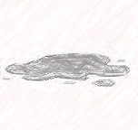
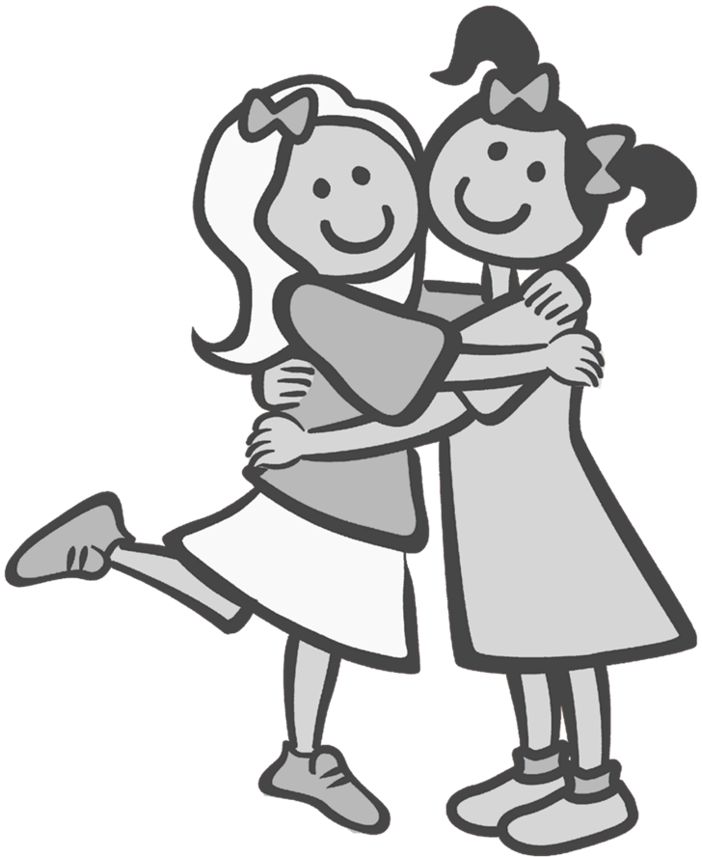
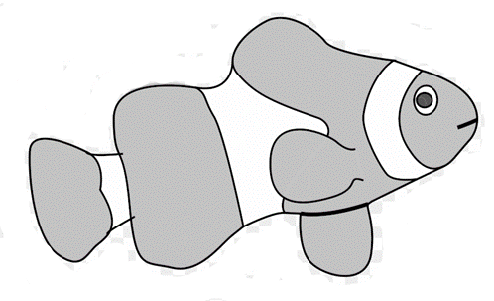
Diversity is natural
Diversity drives evolution

Slide 4
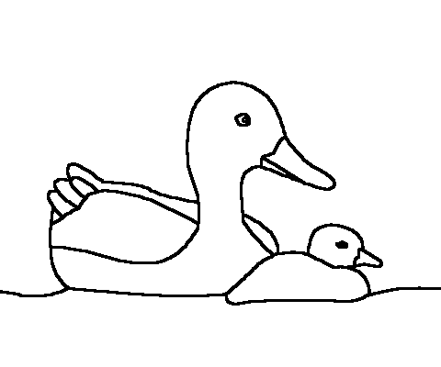
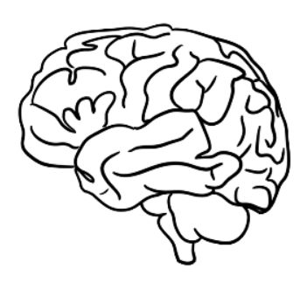
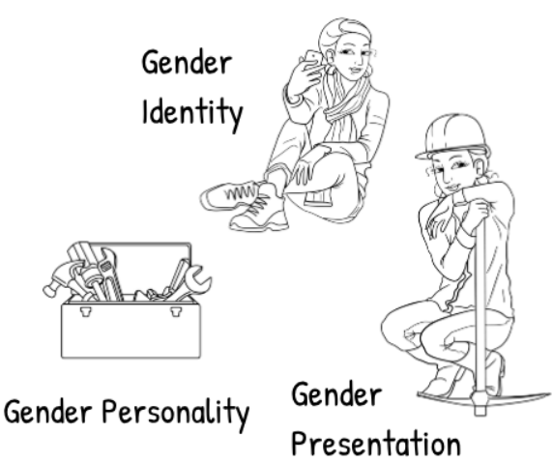
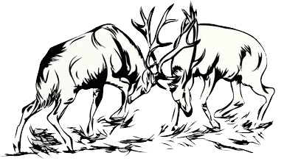
What is gender?
Natural hard-wired behaviours and thought patterns that have evolved to give us our role in our species and in nature
Installed = ‘Girl Software’
Installed = ‘Boy Software’

Slide 5
Gender is…
The identity image and associated role behaviours hardwired into our brains by our biology
Part of vast library of ‘hard coded software’ functions
‘variant’ boy/girl/mixture/in between

Slide 6
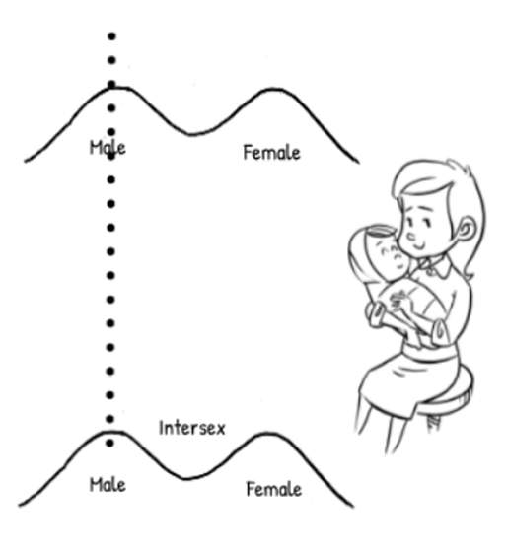
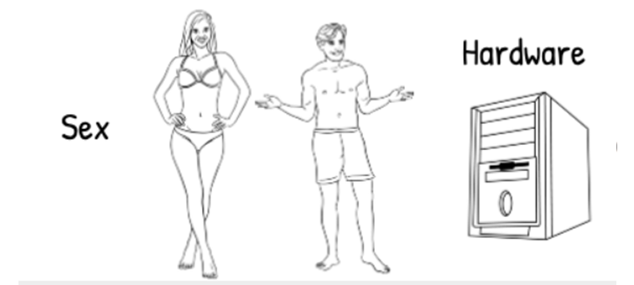
Sex and Gender…
Both are Biologically hardwired - heritable

Slide 7
Evolution
Evolution drivers for sex, gender, sexuality
Physical features
Neurological features
Supporting rearing
Secondary physical sexual characteristics
Secondary behavioural sexual characteristics
Social Structures
Gender roles
and behaviours
Methods of gestation
Mate selection and attraction
Sex
Sexuality
Gender
Methods of delivery and fertilisation
Finding mate - Gender Identity
Methods of Combining DNA
DNA Replication

Slide 8
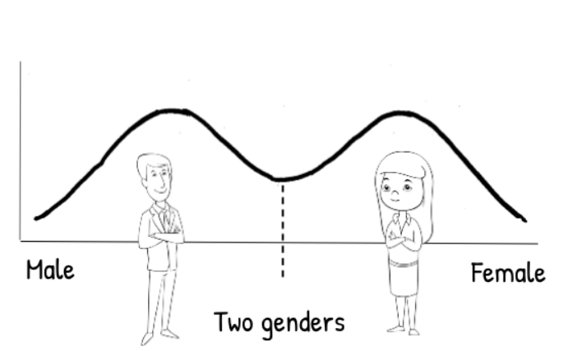
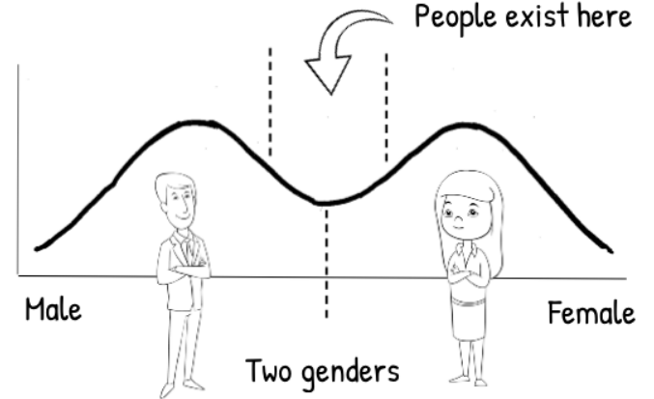
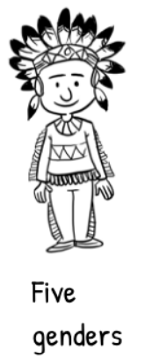
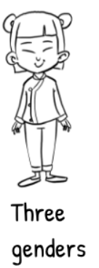
Sex and Gender are not binary
Gender exists on a bi-modal spectrum
Pink
Blue
Sex is also bimodal XX/XY not actually correct

Slide 9
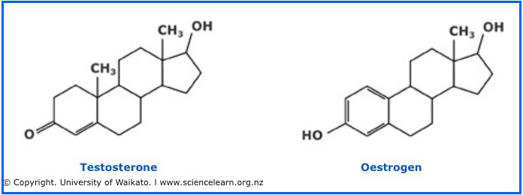
Chromosomes, Genes and Hormones
Chromosomes
XX Female
XY Male
XXY 1/1000
XXX
X0 1/3500
XXXX 1/35000
XXXY
XXYY
XXXXX 1/85000
XXXXY …
Genes
SRY Usually on Y, but not always
XX Male Phenotype
XY Female Phenotype
Epigenetics
Hormones, Testosterone, Oestrogen plus Derivatives

Slide 10
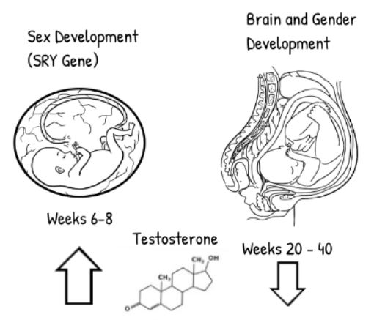
Nature of being ‘trans’
Studies showing biological nature
Twin Studies
DSD cases
Brain structure scans
Behavioral analysis inc using brain scans
Hormone and drug studies
Fully developed by age 3
But biology is complex!
Studies showing psychosocial nature
Many done none found evidence!
‘Evidence shows biologic etiology for transgender identity’

Slide 11
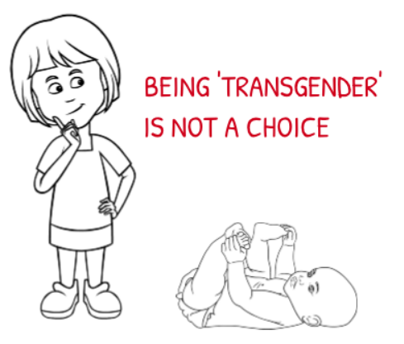
Its Natural
Cannot be caught, coerced, chosen, cured or converted
Its not an ideology (any more than being Autistic is an ideology)
Has been around for as long as humans and is part of natural diversity
Is different to Sexuality (LGB). Sexualities cover the spectrum

Slide 12
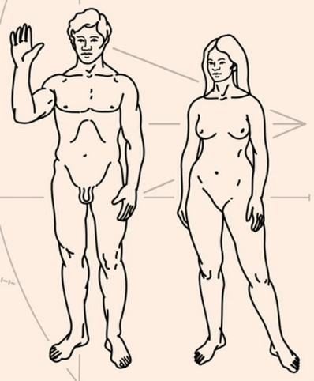
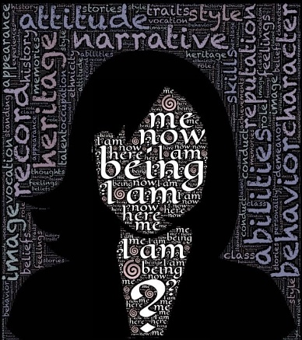
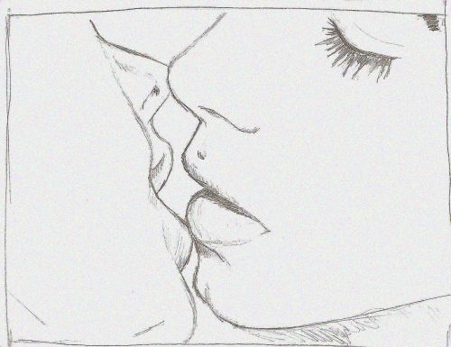
Terminology
Sex
(Male)
(Female)
Intersex
Gender
(Cisgender)
Transgender
(Transsexual)
Non Binary
Agender
Gender Fluid
Sexuality
(Heterosexual)
Homosexual
Lesbian
Gay
Bisexual
Asexual Pansexual
General
Queer
Questioning
Ally
It is important to get the terminology right!!
Notes:
Lesbian - A sexual orientation. A female who is sexually attracted to other females Gay - A sexual orientation. A male who is sexually attracted to other males. Can also be an umbrella term for same sex attraction. Bisexual - A sexual orientation. Is somebody who is attracted to both the male and female gender. Transgender - A gender identity. When someone’s sex and gender identity don’t match. For example a sex based female who identifies as a male. Trans* - An umbrella term encompassing non-cisgender gender identities; When an individual’s sex and gender don’t align. Queer - is a fluid sexual identity. Meaning that the person doesn’t conform to society’s sexual identity boxes. Questioning - Someone exploring in the LGBTQ+ identity. This means the person is unsure of their sexual identity and is in the process of figuring it out. Androgynous - A gender identity. It is where someone exhibits female and male gender characteristics. Ally - Is one who advocates for a community that they do not identify with. For example a gay man advocating for the transgender community. Asexual - Sexual identity. The lack of sexual attraction. An asexual can be romantically and emotionally attracted to anybody and/or specific genders. Intersex - A sex (there is female sex, a male sex, and an intersex sex). An individual containing female and male genitalia, hormones, and internal organs. Pansexual - Sexual orientation. Is where someone is attracted to what’s in the person’s heart, not what’s in the pants. It doesn’t matter what the sexual identity, or gender is, someone who identifies as pansexual can be attracted to anyone. Cisgender - A gender identity. Where a person’s sex and gender identity align/connect.
Transgender vs transsexual: Historically transsexual referred to those who had had surgery as opposed to those who hadn’t, who were called transvestites. Today, however, the term that is used mor is transgender, although older members of the TG community who have had surgery may refer to themselves as TS.

Slide 13
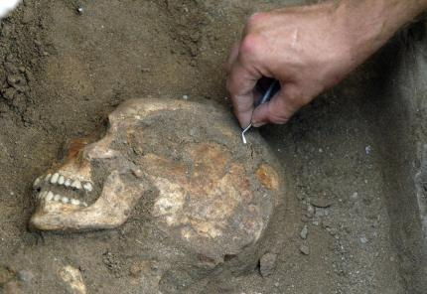
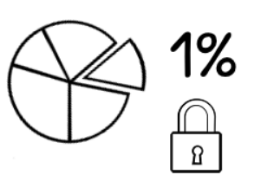
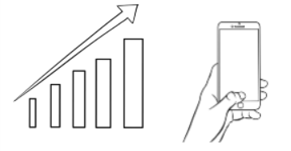
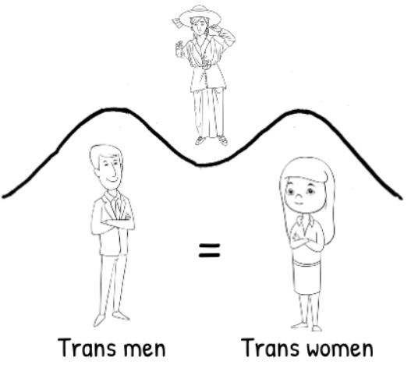
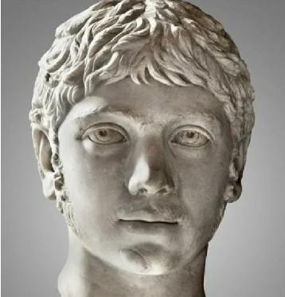
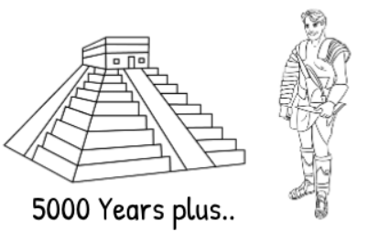
Transgender Stats
Some stats
1:100 trans
1:25gender issue
1:50 Intersex
Growing numbers
Growing visibility and numbers
Notes:
Numbers aren’t known as s
Records go back 5000 plus years
1:100 Trans and 1:25 some degree of gender issue
Was 1:4 FtM but about equal now as easier to
Records go back 5000 plus years
Ranges of intelligence, sexuality are just standard
Growth in coming out is due to technology giving access to information.
o many hidden…

Slide 14
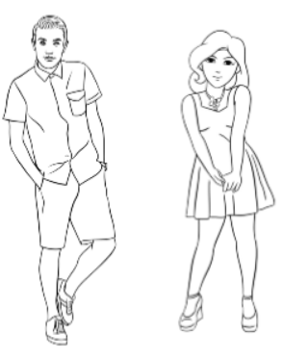
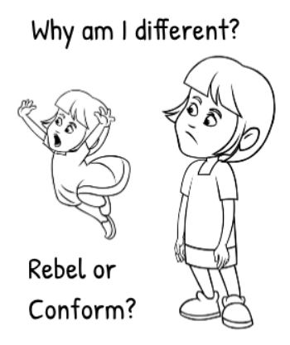
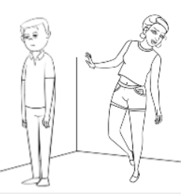
Personal Experience prior to acceptance
Behaviour conflict
Body Dysmorphia
Internal identity
How supposed to behave
How wired to behave
External Senses
Not fitting in has consequences
Notes:
Getting to understand and acceptance
Co-current conditions
Number of steps in transition

Slide 15
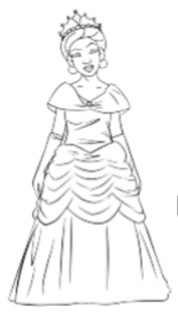
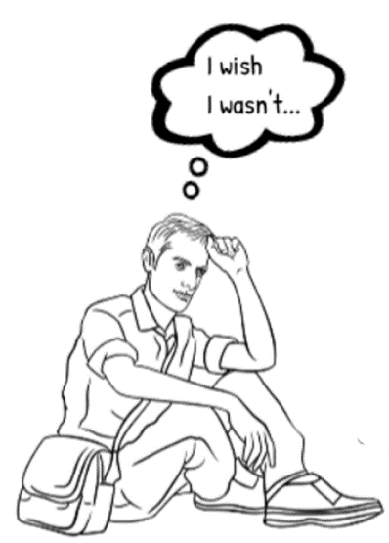
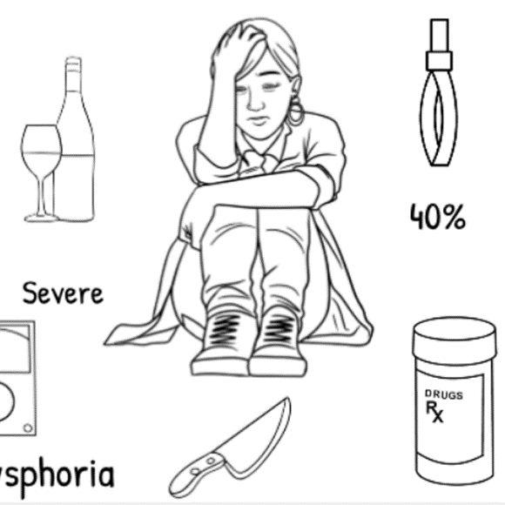
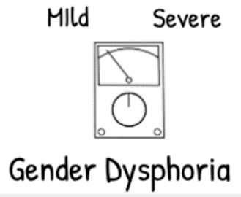
Consequences… prior to acceptance
Guilt, Shame, Fear…
Confused with/by
Autism
BPD
Social Anxiety
Bi-Polar
ADHD
Can fight and hide it for many years before admission

Slide 16
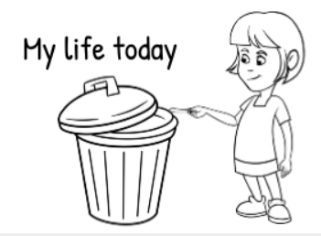
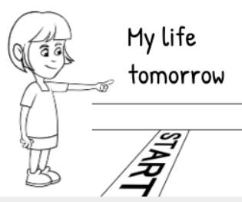
Dealing with…
How dealt with depends on degree of dysphoria.. MtoF different to FtoM different to Non Binary
Its not about surgery
Transitioning involves throwing your current life away and starting again, putting everything at risk
Very little else does this…
And you only do it because you have to..

Slide 17
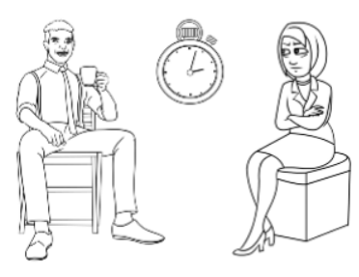
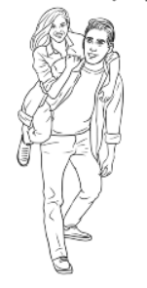
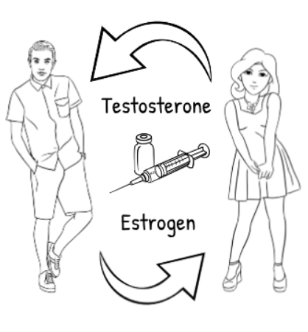
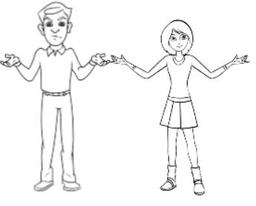
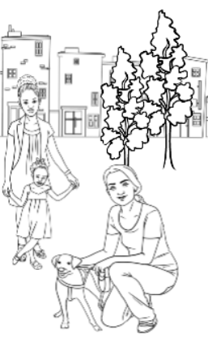
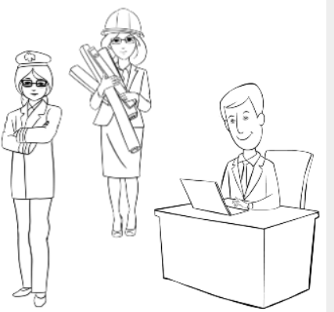
What’s involved…
Relearning to be..
Relationships
Medical
Society
Finding oneself
Officialdom
Work/School
Notes:
7 elements
Medical
Learning to be
Personal Relationships
Society
Officialdom
Work/School
Finding oneself

Slide 18
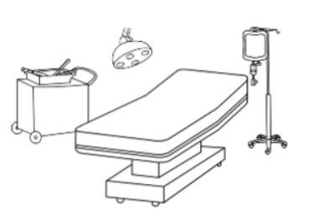
Medical Elements
Covered
Psychiatric assessments x2 plus at a GIC
Subsequent psychiatric services
HRT
Bottom/Top Surgery (only for the few)
Partially covered
Voice coaching
Laser/electrolysis
Gamete storage
Not covered
Facial Feminisation Surgery
Breast augmentation
Vocal surgery
5 to 10 years process never rushed and carefully controlled.
Effects of puberty difficult to overcome and distorts view of trans people
<1% regret rate (very very low) and mainly due to social issues.

Slide 19
Officialdom
Name Change
Numerous methods but have by law to make change universal
No of organisations and rules
Includes gender change
Legal Gender Change
Relevant only in a very small number of situations
Based on registered sex on Birth Certificate
Gender Recognition Certificate
Policies in
Workplace
Public bodies
Schools
NHS
and so on…
No recognition for Intersex or Non Binary
Deed Poll
Passport
Driving license
Banks
NHS
Utilities
Birth Certificate
Notes:
Includes…
Name change
Dozens of organisations
Different Rules
Policies in schools, NHS, councils, etc.
Been forced to withdraw
Inconsistent

Slide 20
As for the rest…
Relearning to be..
Relationships
Society
Finding oneself
For the biggest challenges you are on your own
Notes:
7 elements
Medical
Learning to be
Personal Relationships
Society
Officialdom
Work/School
Finding oneself

Slide 21
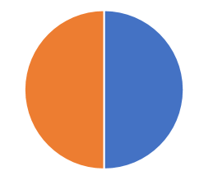
Issues post acceptance
What people think trans issues are
Bathrooms
Pronouns

Slide 22
Issues Post acceptance
What trans issues actually are
Hate and violence against Trans folks
Acceptance, misgendering, deadnaming
Transition costs have to pay for
The rest of life’s stuff, work, school etc.
Relationships rejection and homelessness
Long Waiting times for treatment
Difficulties getting legal recognition and protection
Inadequate local Healthcare services
Trans existence being debated and denied by others
Uneducated Healthcare Professionals

Slide 23
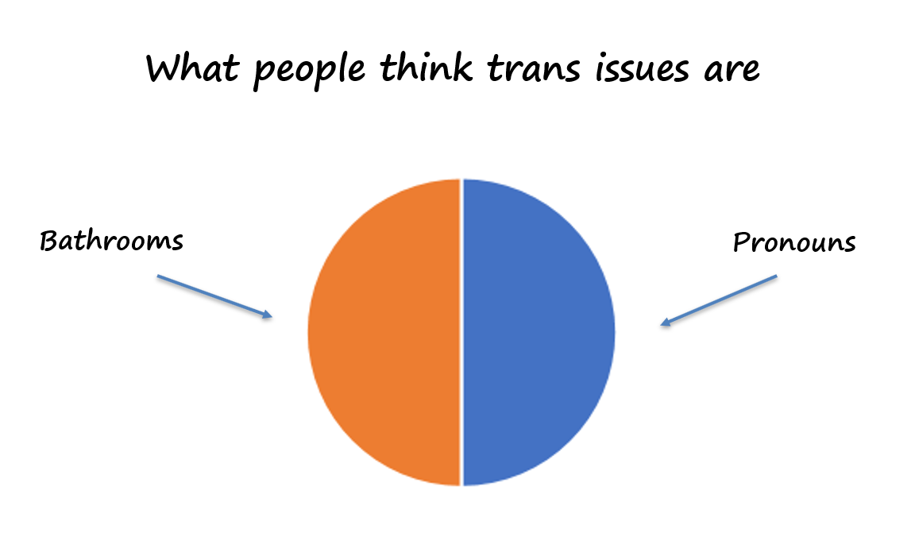
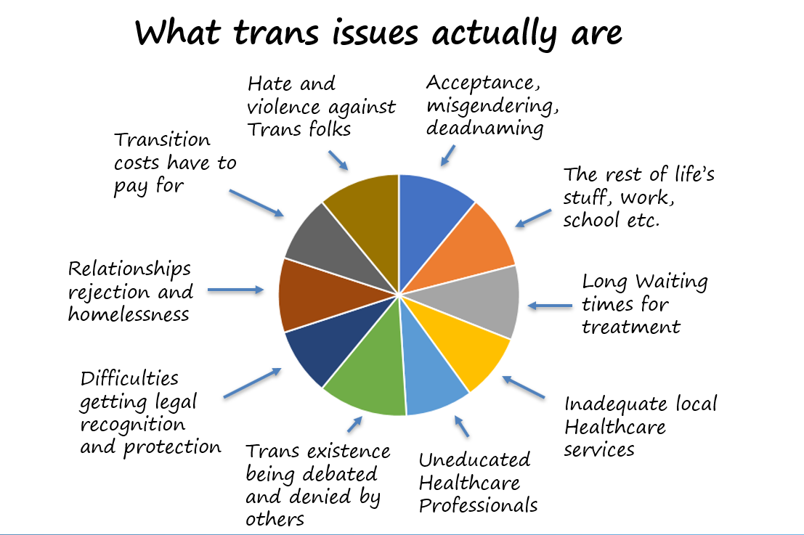

Slide 24
The Real Issues
Medical

Slide 25
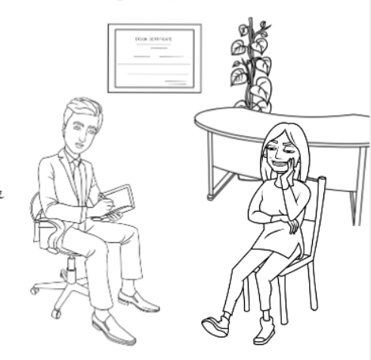
Medical
Gender Clinics (8 off in UK) with unnecessarily demanding pathway requiring registered ‘specialists’ (though no qualification process)
Current waiting times around 4 years from referral to first appointment
Other related services (e.g. surgical) limited or non existent
Private, importing and self medication, going abroad.. Not approved of though…

Slide 26
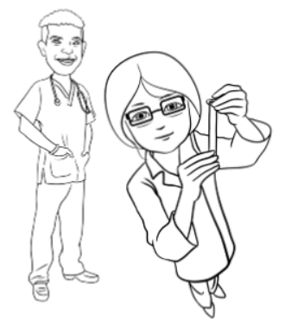
Medical
GP’s have no training and often refuse to support (though nothing complex to learn)
Other services (mental health, endocrinology..) continue to demonstrate limited knowledge with detrimental consequences
GMC etc guidelines not always up to date and ignored
Approach to trans folks often ignorant, wrong, discriminatory and potentially illegal (and this is nothing to do with bathrooms and pronouns)

Slide 27
The real issues
Legal

Slide 28
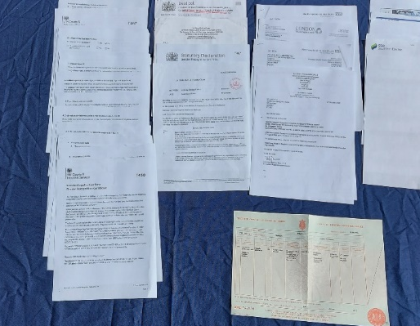
Legal
Gender Recognition Act 2004
Enables correction to legal gender/sex marker where used in gender differentiated legislation
Restrictive, unnecessarily demanding, superseded limited benefits
Pointless by time can apply for it so only 1% of trans folks have been bothered
Needs reform but Govt too scared to do so
Equality Act 2010
Good set of rules about discrimination especially for protected characteristics.
Gender reassignment the characteristic and should really be Gender Identity
No recognition for intersex or Non Binary folks
No Hate crime legislation

Slide 29
The real issues
Social

Slide 30
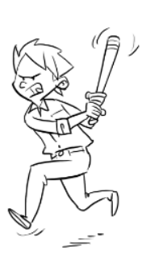
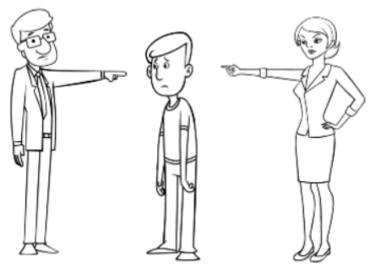
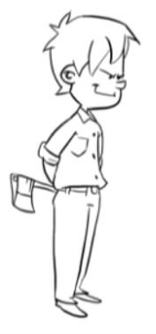
Personal Level
Domestic violence and abuse
Rejection and Ejection
Bullying at school or work
Family targeted too
Denial by Family and Partners
Notes:
Family denial
Family/partner rejection/thrown out
Domestic mental and physical abuse
Bullying at school and work
Family may be picked on too….
Lack of understanding and supporting material
Leelah

Slide 31
Society Level
We are a targeted group especially at the moment
Rape
Implicit Discrimination
Murder
Extreme Ideologies
Ignoramuses and Bigots
Trolling
Physical and Verbal Abuse
Demonisation and misrepresentation
..It is society that is a threat to us not the other way round

Slide 32
Anti-trans campaign
Started fighting a few years ago
Small group with extremist religious, political ideologies opposed to the existence and acceptance of transgender people (based on only sex and its binary)
Remove rights, access to healthcare, ability to work in public services, removal of public and other group support rendering it impossible for trans folks to exist in society
Three pronged strategy
Propaganda and media manipulation
Creating ‘good cause’ wedge groups to stir up transphobia, attack trans folks and destroy their support
Lawfare

Slide 33
Anti trans campaign
Demonisation of Trans folks and their supporters as dangerous activists and as threats to society
Systematic challenges to supporters and services (e.g. Mermaids, Guides, YHA, Stonewall…)
Legal challenges to rights and treatment ‘religion or sex should win over gender’
Extensive use of media to promote crude emotional messages and misinformation
Forming and supporting groups to promote culture war. Feminists, LGB, religious…
Ignoring science and research and using fake science
Shut down response from trans community and supporters claiming suppression of free speech, victimization, etc.

Slide 34
Post transition
The positives
Being able to be true to yourself is truly wonderful
Get on with life… blend in with trans being no longer a thing
Not about being happy its about being at peace
But still have issues with
Escaping ones past
Rejection from family/friends
Relationships and loneliness
Medical issues (mental and physical)
There are some that ‘get stuck’ by choice or otherwise
They can have additional problems
But regret/detransition rate is <1% . Its rare, generally the result of social rejection and often only temporary.

Slide 35
Trans related law
Truth and lies

Slide 36
The applicable laws
Equalities Act 2010
Rules regarding discrimination protected characteristics (sex, religion, race,…)
Combined a number of discrimination laws into one
Gender reassignment is characteristic … but no specific criteria for proving this (or any other characterstics)
Gender Recognition Act 2004
Enables correction to legal gender/sex marker that is used in legislation where gender differentiation exists.
Provides protection of use of history of the individual
Result of Human Rights case against law that had been put in place in 60’s following Ewan Forbes Case

Slide 37
And then there’s
Laws providing protection including
Offences against the Person Act 1861
Sexual Offences Act 2003
Voyerism Act 2019
Data Protections Act 2018
But no hate crime legislation

Slide 38
Why reform the GRA?
Unnecessarily complex process for what it now delivers
Requirements too restrictive
Superseded benefits – Marriages Act, Equality Act, Data Protection…
Premise for process now invalid as better understanding of condition
By time can apply for GRC largely irrelevant.
No recognition for intersex or non binary
Only 1% of Transgender people have bothered

Slide 39
The myths about GRA and reforms
Allow Self Identification (we all do that) and be barrier free (it won’t)
Allow access to bathrooms or ‘safe spaces’
Conflict with other’s rights (and I should know) That’s the EA and the EA works.
Enable people to identify as carrots or Klingons
Invalidate biological sex.. though brain always wins
Encourage kids and others to change gender
Is unproven – many countries have self registration already and the sky has not fallen!

Slide 40
Trans Children and Youth
Truth and lies

Slide 41
Kids and myths
Can’t know at that age
Gender identity has matured and been locked by age 3. We know it as a child even if it confuses.
It’s a fad, they’ll grow out of it
Challenging and exploring societal gender norms is part of growing up but being trans is entirely different and is about who you are biologically. The two should not be confused and being trans is lifelong
GIDS (trans kids service) rushes treatment
There is a minimum of two year waiting list. As a kid that wait is devastating. There is no rushing
Psychological assessment of gender identity is the primary process. It is rigorous and challenging intended to sift the genuine from the maybe’s
Its all about puberty blockers and surgery
Social transition is what it is about. Any medical intervention is secondary and only intended to delay development until deemed mentally mature enough to make next stage decisions.
Earlier deal with it better the outcomes
Puberty blockers are experimental
They’ve been used for over 50 years to treat a range of conditions and simply trigger natural biological processes. Their effects are fully reversible on termination of treatment
Parents are abusing children by supporting their gender incongruence
Parents cannot influence gender identity. They simply have to go with what they are given. Supporting ones child is essential to that child’s long term well being
Acceptance by parents and family is the difference between a successful life and tragic life for the child
Acceptance and support
Education of those around
Marginalization of deniers and haters

Slide 42
A Mothers Story
My daughter is transgender. In no way does that make her a pervert, a rapist, a paedophile or a threat to anyone else! She’s not a drag queen or a cross dresser, She's not a boy that wants to be a girl. SHE IS A GIRL. I'm tired of the media demonizing transgender people and making them look like a danger to society when in fact it's society that's a danger to them and other LGBTQ+ people! This myth that you can wake up one day and decide to identify as somebody else is just ignorant bullshit. Being transgender is real. It's a long, painful, invasive, difficult, expensive, official process which requires ongoing medical and psychological testing, procedures and official diagnosis. My daughter is human, she's not a fad, she's not a trend, she’s not a freak. She's a real person with real feelings. Ultimately she's just a girl that should be treated like any other girl.

Slide 43
Ordinary people
Notes:
At the end of the day most of us are just very normal folks. (these are, aside from Paris Lees at the bottom, local trans friends of mine)

Slide 44
Who I seemed to be…
Notes:
Was brought up and accepted as Male and labelled a typical Male
Qualifications and own IT business
Family and friends
Interests MGB, boat, am dram, music, creativity and DIY
I struggled as what I was supposed to be didn’t come naturally, had to learn a lot
White Male privilege … which I didn’t really understand until I came out.

Slide 45
… But who I really was
Notes:
I was still the same person
Still had my qualifications and business
Still had my family and friends
Still had my interests, my MGB, boat, am dram, music, creativity and DIY
I had really only changed my exterior to enable me to be true to myself and the world.
I am being totally natural and am accepted without question as being female

Slide 46
And how to treat us?
Do’s
Treat us like anyone else of the relevant gender. Treat us normally
Learn, from trans folks, about what we go through and learn where we are in the process
Recognise the challenges we face and be understanding. Check we’re getting the support we need…
Recognise the hate campaigns and be wary to the lies and misinformation they push out.
Be a proactive ally (call out false propaganda, attend meetings… )
Keep up with inclusivity policies and raise any questions
Don’t
Patronise us or ask personal questions without permission
Deadname us or refer to our past as if it was something real to us. We’ve only ever been the person we’ve come out as and the previous person was only someone we were forced to try to be.

Slide 47
Some of the challenges
Trans youth
Family rejection and denial
Families when one parent comes out
Family split up
Children open to bullying etc.
Not a lot of material for children, schools…
Personal Issues
Loneliness (especially in older age)
Homeless and work issues
ASD and Trans

Slide 48
To be yourself in a world that is constantly trying to make you something else is the greatest achievement
Ralph Waldo Emerson

Slide 49
“To live is the rarest thing in the world. Most people exist that is all.”
Oscar Wilde

Slide 50
Thank You
Any Questions?

Slide 51
Key Points
Need to educate the public on being trans
Address the failings in the medical services
Address the legal needs and call out the ideological based transphobia and put it in its rightful place.

Slide 52
The spy who came in from the controlled…
Hannah Massie

Slide 53
Nature and societies
Tournament
Pair bonding
Patriarchal
Matriarchal

Slide 54
Observation One
The gendered brain does exist…
T vs E
Ethology Plus
…on a spectrum and that’s good not bad!
Notes:
Men and women really do think differently
There has been some attempts to claim equality by denying the differences
We experience from inside rather than as observers
Treated differently
Have to observe, learn and try
Problem solving vs empathy
Aggression/Posturing vs manipulation and ‘The all women clause’
Sex
The gender spectrum is real and is good and doesn’t go against the feminist cause. It is giving a balance to voice and in decision that is important.

Slide 55
Observation Two
The Gender Dynamic
… but strength gained from conformity
Female
Male
Considerably larger range of expression for women….
Notes:
Understand what has been achieved and the gender dynamic
Gender expression for women wider (not just clothes but language)
Something that has been ‘gained’
Makes it difficult for trans women…
Makes women more accepting of variance.
Men narrower and this strength in numbers helps maintain control.

Slide 56
Observation Three
A lot of sexism goes unnoticed …
…because it is small and normalised
Notes:
There’s a lot of sexism is not noticed because it small and normalised.
Bill stories
But works both ways
Seats, car stopping to let me cross

Slide 57
Observation Four
Still a long way to go in the workplace
We expose prejudices that underlies implicit discrimination, especially the being less capable/valuable…
But on the plus side we can exploit these to our advantage …. Play the egos!
Despite the training and inclusivity statements
Notes:
Sexism is in the workplace despite training.. workplace.
Meetings
Having to put the letters after my name
However it can be beneficial

Slide 58
Observation Five
Culturally created and perpetuated
We highlight the baselessness and absurdities
Notes:
We denounce our original indoctrination but have sidestepped the indoctrination we should have had.
Gives us an interesting perspective and experience

Slide 59
Observation Six
The current campaign against trans folks
Race
Feminism
Trans
Equality is for all otherwise it is just a different type of inequality
LGB
Creed
Sets groups against each other but will come after all
Notes:
The attempts to erase trans people is just the current field of play.
It is playing off ignorant women against trans people
But it will come after LGB and womens rights
We must stick together and expose and denounce not fight amongst ourselves

Slide 60
Thank You
Any Questions?

Slide 61
Whats behind the current anti-trans campaign?
Hannah Massie

Slide 62
The Campaign Start
Evangelical far Right Christians in US
Family Research Council, Heritage Foundation…
Well funded and organized
Heavily connected into Republican/Trump political circles
Turned attention to trans folks in 2015-2016
But still against LGB, women’s rights…

Slide 63
The Campaign Start
Strategy document whose key aims
Remove access to healthcare
Remove rights
Remove ability to serve in public offices (e.g. military)
Remove support for trans kids and youth
Conversion therapy and eradication of trans folks from society
Purely ideological ‘There is only sex and its binary, men and women’. Claiming Gender to be a dangerous and false ideology
Use of false ‘science’ to give sense of ‘authenticity’
Set up wedge groups like WOLF
Bathroom bills, bans on trans in military, legislation against trans healthcare, participation in public activities.

Slide 64
Shipped into the UK and other countries
Introduced through associate organisations such as Christian Concern
Small group of folks with expert knowledge in law and campaign strategy, media strategy, political lobbying….
Three pronged strategy
Pushing, propaganda, misinformation and media manipulation (MSM and social)
Split and isolate trans folks from their supporters and general public by creating ‘good cause’ wedge groups to stir up transphobia, attack trans folks and attack and destroy their support in identified areas
Lawfare

Slide 65
Well practiced approach
There was no point in seeking to convert the intellectuals. For intellectuals would never be converted and would anyway always yield to the stronger, and this will always be “the man in the street.” Arguments must therefore be crude, clear, and forcible, and appeal to emotions and instincts, not the intellect. Truth was unimportant and entirely subordinate to tactics and psychology.
Activate the limbic system, amygdala and insula cortex… and appeal to those with limited critical thinking capabilities

Slide 66
Propaganda
Classic Us and Them’ing (Kin selection)
Demonisation and dehumanising (media love this)
Danger and threat to the safety and rights of ‘ordinary’ women, children and folks.
Demanding activists, deluded, dangerous predators and offenders (sandmen)
Denying validity of trans folks and the actual science
Pushing false information about treatment, rights, ‘erasure’, detransition and so on…
When challenged claim trying to be silenced, trying to have freedom of speech suppressed.. Being victims of ’wokeness’ or ‘cancel culture’ while aggressively silencing opponents
Making high profile transphobes into ‘victims and martyrs’. JK Rowling (national treasure), Kathleen Stock (academic freedom)….
Susan Fisk
Social Psychology Princeton University

Slide 67
Divide and conquer
Set up groups that claim to represent those who are threatened by trans folks
Feminists
LGB folks
Religious folks
School children
On surface good cause but primary purpose is promoting transphobia and trans exclusion
Trying to depict conflicts in equalities act (sex vs gender rights)
Attack supporters and especially Stonewall. But also Mermaids, councils, YHA, Guides and any group supporting trans folks
Use these groups for political and other lobbying
A lot of cross over of those involved in these groups
Seed funded from ‘crowd sources’ and common back office support
Extensive use of Social Media (e.g. Mumsnet) with dog piling a common tactic especially using sock puppets.

Slide 68
Lawfare
Legal cases to challenge access to healthcare, rights, organisations
Raise £25k to £100k plus through black money crowdfunding in matter of days
Cases against Supporters – Councils, Stonewall, knowing they cannot readily afford defense costs
Threaten cases against anyone who challenges them. Libel etc. knowing that those threatened cannot afford to defend the cases and therefore will silence them.
Use impressionable individuals to front these cases (13 year old schoolgirl)
Common legal team (Paul Conrathe)
Heavily publicise successful cases. Bury the many unsuccessful appeals and cases.

Slide 69
Constant media attack
900 Trans articles in Mainstream Media in 2018

Slide 70
Not seen though…
Less than 5% of those articles contained trans input

Slide 71
Community response
Small extremely diverse group.. <1%
Already have enough to deal with
Confused, fragmented, ill equipped, lack cohesion…
A lot of small ‘competing’ organisations GIRES, Gendered intelligence, Trans Actual, Beaumont society… Mermaids is one of the stronger and complete ..and Stonewall…
Been all over the place but have slowly been galvanising and have had a growing number of successes especially when supported by appropriate organisations.
Now crowd funding the good law project who has taken up cases
Strategy
Education
Individuation (showing ’normal’)
Promoting the actual science and research
Using media to call out lies, misinformation and hate campaign
Getting support from major organisations and groups Medical, Unions, political….

Slide 72
How can you help?
Educate yourself about the truths about being trans
Call out the false statements about biology and ideology
Challenge false claims being made about trans folks, their rights, their treatments, etc. and expose the lies
Financially support the legal cases fighting the anti’s
Call out the hate groups like LGB Alliance. We are stronger together. Remember the originators deny LGB existence too.
Support conversion therapy ban
Help improve medical services

Slide 73
Gender in nature
Notes:
This slide talks about how gender is how your brain is wired to fulfil your role in nature and how this is hardwired. These are examples of animals in nature where clear gender differences are visible. This is applicable to humans too

Slide 74
Diversity
Notes:
This slide talks about how nature doesn’t work in simple fixed binary rules but is constantly changing and creates and uses diversity to drive that evolution, leading to all sorts of ‘rule breaking’ animals. With Sea Horses the male gets pregnant and gives birth, ther primary male clown fish (nemo’s) changes sex on the death of the primary female and takes her place. The white throated sparrow has 4 distinct genders, two female and two male. Each gender has different behavioural characteristics and brain structures. Guevedoces are children from a small area in the Dominican republic who are born looking like girls and are bought up initially as girls but who grow penises and ‘change sex’ when puberty hits at 12.

Slide 75
Discrimination and hate?
There’s a lot of trans specific at the moment
Bullying at school/work
Media… Anything that can be exploited as anti trans
Radical Feminists (TERFS), Religious, right wing and other extremists/idealogies…
Verbal and physical abuse including murder…
Based on misunderstanding, misconceptions and ‘fear’.
We are not a threat to Society. Society is a threat to us.
Equalities Act, Gender Recognition Act.
We may also get the LGB and other issues on top of this…
Notes:
The trans woman being beaten to death was in brazil and was videod by the perpetrators and then posted to social media where it remained long enough for it to gain significant attention. What was shocking, aside from the murder and the posting, were the comments that praised the perpetrators.

Slide 76
The Biology is understood
Transgender people are biologically valid

Slide 77
Gender Clinics
Gender Clinics ( 8 off in UK) and very strict process, registered specialists
Current waiting times around 4 years from referral to first appointment. Legal requirement is for 18 weeks.
Not all accepting referrals
Not Covid19 related years old.
Actually limited services and surgeons
Private, importing and self medication, going abroad.. Which then get attacked by the GIC mafia
Suggestion that people are rushed into it absurd!

Slide 78
GP’s and local services
GP’s have no training and have no better understanding than the general public. Constantly making mistakes in treatment and referrals.
Numerous GP’s have refused to support and treat trans patients even when under supervision by clinics (just normal drugs nothing special)
Mental and local endocrinology etc. health services are no better in their understanding and regularly get it wrong

Slide 79
Medical Practices
GMC and other medical bodies do publish guidance on supporting trans patients but this is generally ignored by practitioners
Processes operated by medical services for supporting gender incongruent patients vary vastly and pretty shambolic, even to the point of being illegal. We get discrimination on top of everything else.
Other government services e.g. schools better, but also a lot of variation.

Slide 80
Treated in society
Based on ignorance and bigotry

